Slide 1


PHARMACY INVENTORY MANAGEMENT SYSTEM
SQL-Based Database Design
Prepared by
Academic Mentor
Vivek Chincholkar
Shalini Verma
Tools Used: MySQL / SQL Database Language

Slide 2


Project Overview: Building the Foundation
We have designed a comprehensive, relational database system built on SQL principles to effectively manage core pharmacy operations and workflow.
Core Functionality
System Goals
Tracks medicines, suppliers, purchases, sales, prescriptions, and real-time inventory levels.
Ensures data consistency, automation of repetitive tasks, and facilitates accurate reporting for management.

Slide 3

Key Project Objectives
The system focuses on optimizing critical pharmacy functions across procurement, customer service, and regulatory compliance.
Stock Optimization
1
Streamline medicine procurement and ensure precise, real-time stock management.
Prescription Tracking
2
Accurately track prescriptions, customer fulfillment history, and associated insurance claims.
Process Automation
3
Automate sales recording and purchase order generation to improve speed and reduce effort.
Efficiency & Accuracy
4
Significantly improve overall operational efficiency and minimize the potential for human error in data entry.

Slide 4

Database Architecture: Foundations
The database, named Pharmacy\_Inventory\_Management, is a highly structured, relational model designed for robust performance and integrity.
Comprehensive Scope
Data Integrity
Composed of 25 interrelated tables covering all aspects of the business.
Implements strict Primary and Foreign Key constraints to enforce referential integrity and consistency.
Design Intent
Designed to support robust offline operation with secure, synchronized real-time data updates.

Slide 5





Core Master Entities
These five tables hold static, foundational data essential for all transactional processes.
Suppliers
Manufacturers
Products
Detailed contact and history of all medicine distributors and wholesalers.
Information on companies producing the pharmaceutical products.
All stock items, including price, dosage, and product metadata.
Inventory
Customers
Tracks current stock counts, lot numbers, expiry dates, and automated reorder points.
Patient demographic details, including contact information and health insurance data.

Slide 6

Transactional Tables: The Workflow Engine
These tables capture the dynamic, day-to-day operations and financial movements within the pharmacy.
1
Prescriptions
Tracks doctor's orders; links to Customer and Product entities via Prescription\_Items.
2
Purchase Orders
Manages orders placed to Suppliers; fulfilled products tracked in Purchase\_Order\_Items.
3
Sales Records
Records customer transactions; detailed fulfillment documented in Sale\_Items.
4
Payments
Manages all incoming and outgoing payment types and detailed transaction records (cash, credit, insurance).

Slide 7


Operational & Workforce Management
Beyond inventory and sales, the system supports internal management of personnel and expenses.
Employees
Shifts & Scheduling
Details on all staff roles (pharmacists, technicians, managers) and access credentials.
Defines shift times and links staff to schedules via the Employee\_Shifts table for attendance tracking.
Vendors & Contracts
Expenses
Records external service providers (e.g., maintenance, IT) and associated service agreements.
Categorized tracking of operational costs (e.g., rent, utilities, salaries).

Slide 8


Customer Health & Insurance Management
Dedicated entities ensure accurate handling of patient demographics, insurance policies, and claim processing.
Customers (Patients)
Stores secure demographic data, contact info, and patient-specific identifiers.
Insurance Providers
Details of partner companies, policy types, and coverage rules.
Insurance Claims
Tracks the status, submission dates, and reimbursement records for all processed claims.
Patient Medical History
Records chronic conditions, allergies, and past treatments to support safe dispensing.

Slide 9



Key Data Relationships
Relational integrity is paramount. These examples illustrate the established connections between core entities.
One-to-Many: Suppliers to Products
A single Supplier can provide multiple Products, but a Product is primarily sourced from one main Supplier.
Chained One-to-Many
A Customer can have many Prescriptions, and each Prescription contains multiple Prescription\_Items.
Many-to-Many: Products & Orders
A Product can appear on multiple Purchase Orders, and an Order contains multiple Products (resolved by the Purchase\_Order\_Items linking table).
Enforcement: All relationships rely on mandatory Foreign Key constraints to maintain data consistency.

Slide 10








Summary: Features & Business Benefits
The system is designed not just for data storage, but as a strategic tool for managing and growing the pharmacy business.
Centralized Data Hub
Workflow Automation
All operational data is unified, ensuring a single source of truth across all modules.
Significant time savings through automated purchase order generation and sales recording.
Enhanced Decision Making
Real-Time Visibility
Leverages structured data for analytics, optimizing inventory, pricing, and procurement strategies.
Instant tracking of inventory, stock levels, and critical medicine expiry dates.

Slide 11

PHASE 2 OVERVIEW: ADVANCED SQL FOR PHARMACY DATA
Phase 2 of our development focuses on mastering advanced SQL operations crucial for managing high-volume, sensitive healthcare and pharmacy data. This phase involves extensive work across 25 distinct database tables.
Technical Depth
Key Concepts
Demonstrate proficiency in DDL, DML, DQL, and analytic functions.
Applying Joins, Clauses, Logical Operators, and Aggregations.
Strategic Goal
Focus on automated data maintenance and complex reporting requirements.

Slide 12




SQL COMMAND CATEGORIES: THE DATABASE TOOLKIT
SQL commands are structured into categories, each serving a specific purpose in database management, from structural definition to data extraction.
DDL (Data Definition Language)
DML (Data Manipulation Language)
Used to define and modify the database structure and schema.
Used to manipulate the data records within the tables.
DQL (Data Query Language)
Clauses & Joins
Used to query and analyze data to extract meaningful information.
Essential for filtering, sorting, and combining data across relational tables.

Slide 13
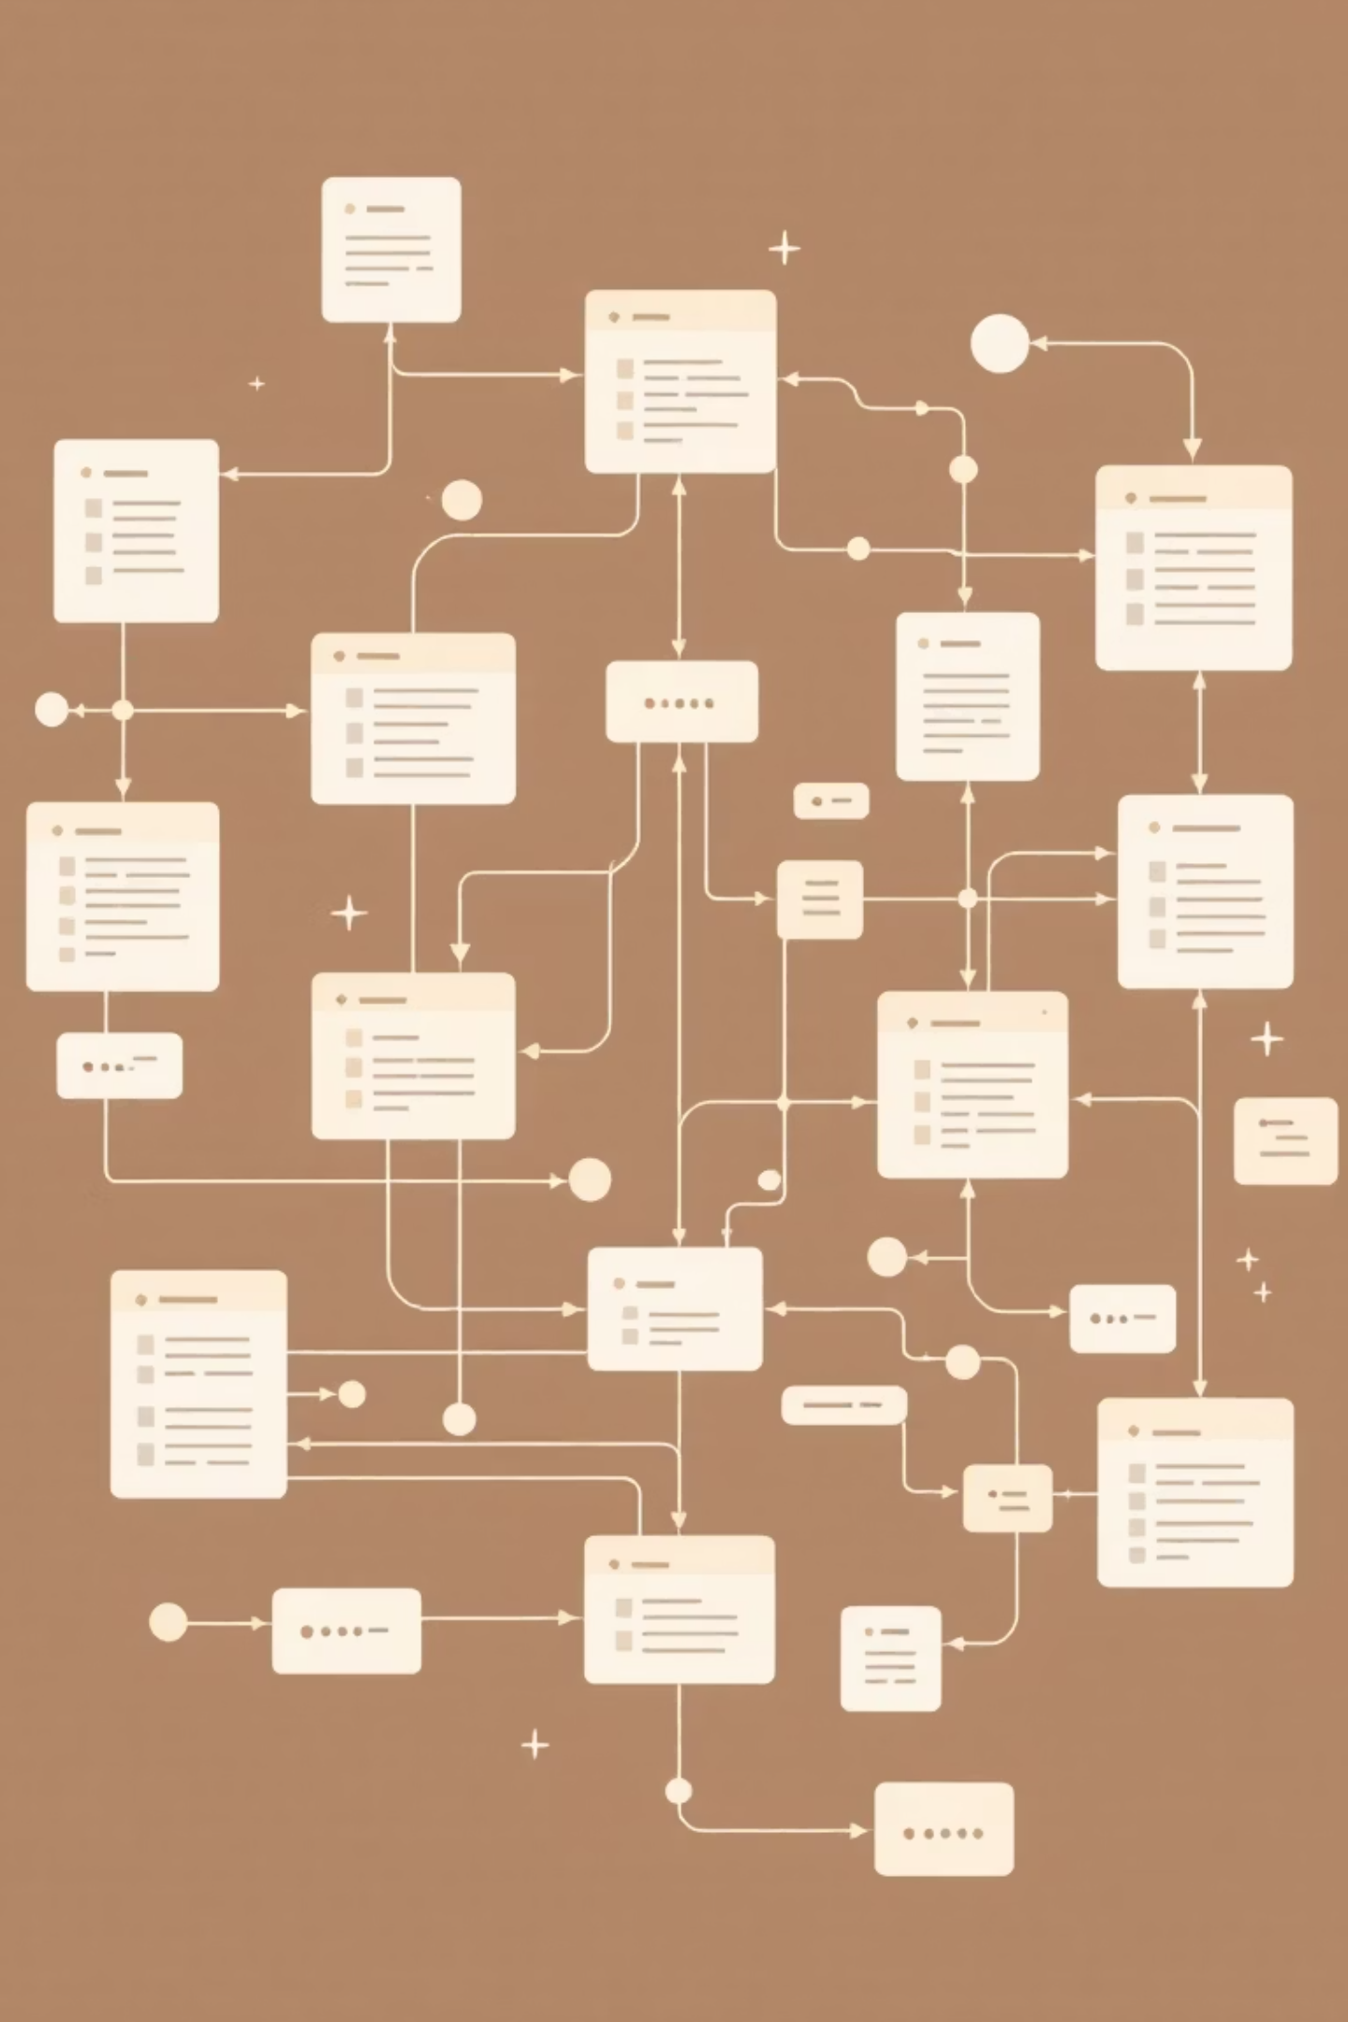
DDL OPERATIONS: SCALING THE SCHEMA
DDL operations enable dynamic modification of database objects like tables, indexes, and views. This ensures the pharmacy database remains scalable and adaptable to evolving business requirements.
Action: Add status column to Suppliers table
ALTER TABLE Suppliers ADD status VARCHAR(20) DEFAULT 'Active';
DDL commands allow us to add columns, define constraints, and modify schemas without data loss.
This flexibility is critical for integrating new data fields, such as compliance statuses or supplier classifications.

Slide 14

DML OPERATIONS: ACCURACY AND STANDARDIZATION
DML commands such as UPDATE and DELETE are essential for maintaining the integrity and quality of the pharmacy data. These operations ensure records are current, accurate, and standardized according to established protocols.
Action: Standardize product names
Converting low-priced product names to uppercase for consistency.
UPDATE Products SET product_name = UPPER(product_name) WHERE unit_price < 10.00;
The UPDATE command modifies existing records, helping to enforce data standardization (e.g., proper casing, format).
The DELETE command removes obsolete or erroneous entries, keeping the database clean and optimized.

Slide 15
DQL OPERATIONS: EXTRACTING BUSINESS INSIGHTS
Querying for Decisions
SELECT Statement
Business Value
Example
The core of DQL, used to retrieve data from the database.
Extracts data needed for inventory management, patient records, and sales monitoring.
SELECT COUNT(*) AS total_suppliers FROM Suppliers;
By utilizing DQL, we can generate real-time metrics, such as the total count of active suppliers, to support operational monitoring and inform strategic decisions about procurement and partnerships.

Slide 16

CLAUSES AND OPERATORS: DATA CONTROL AND FILTERING
Clauses like WHERE, GROUP BY, ORDER BY, and HAVING are the mechanisms used to control the flow and grouping of data within a query. Logical operators (AND, OR, NOT) enable complex, multi-condition filtering.
1
Filtering (WHERE)
Used to apply conditions to individual rows before grouping.
2
Grouping (GROUP BY)
Aggregates rows that have the same values into summary rows.
3
Post-Grouping Filter (HAVING)
Filters groups based on aggregate conditions (e.g., showing cities with >10 suppliers).
Example: Count Suppliers by Location
SELECT city, COUNT(*) FROM Suppliers GROUP BY city;

Slide 17

ANALYTIC FUNCTIONS: AGGREGATING FOR PERFORMANCE
SQL's aggregate functions are vital for quantitative analysis and performance tracking. They summarize data across groups of rows, providing key analytical insights.
COUNT
SUM
Row Tally
Total Value
Counts the number of rows or non-null values.
Calculates the sum of a numeric column.
AVG
MIN/MAX
Mean Metric
Extremes
Determines the average value.
Finds the smallest or largest value.
Example: Calculate Total Sales
SELECT SUM(total_amount) AS total_sales FROM Sales;

Slide 18
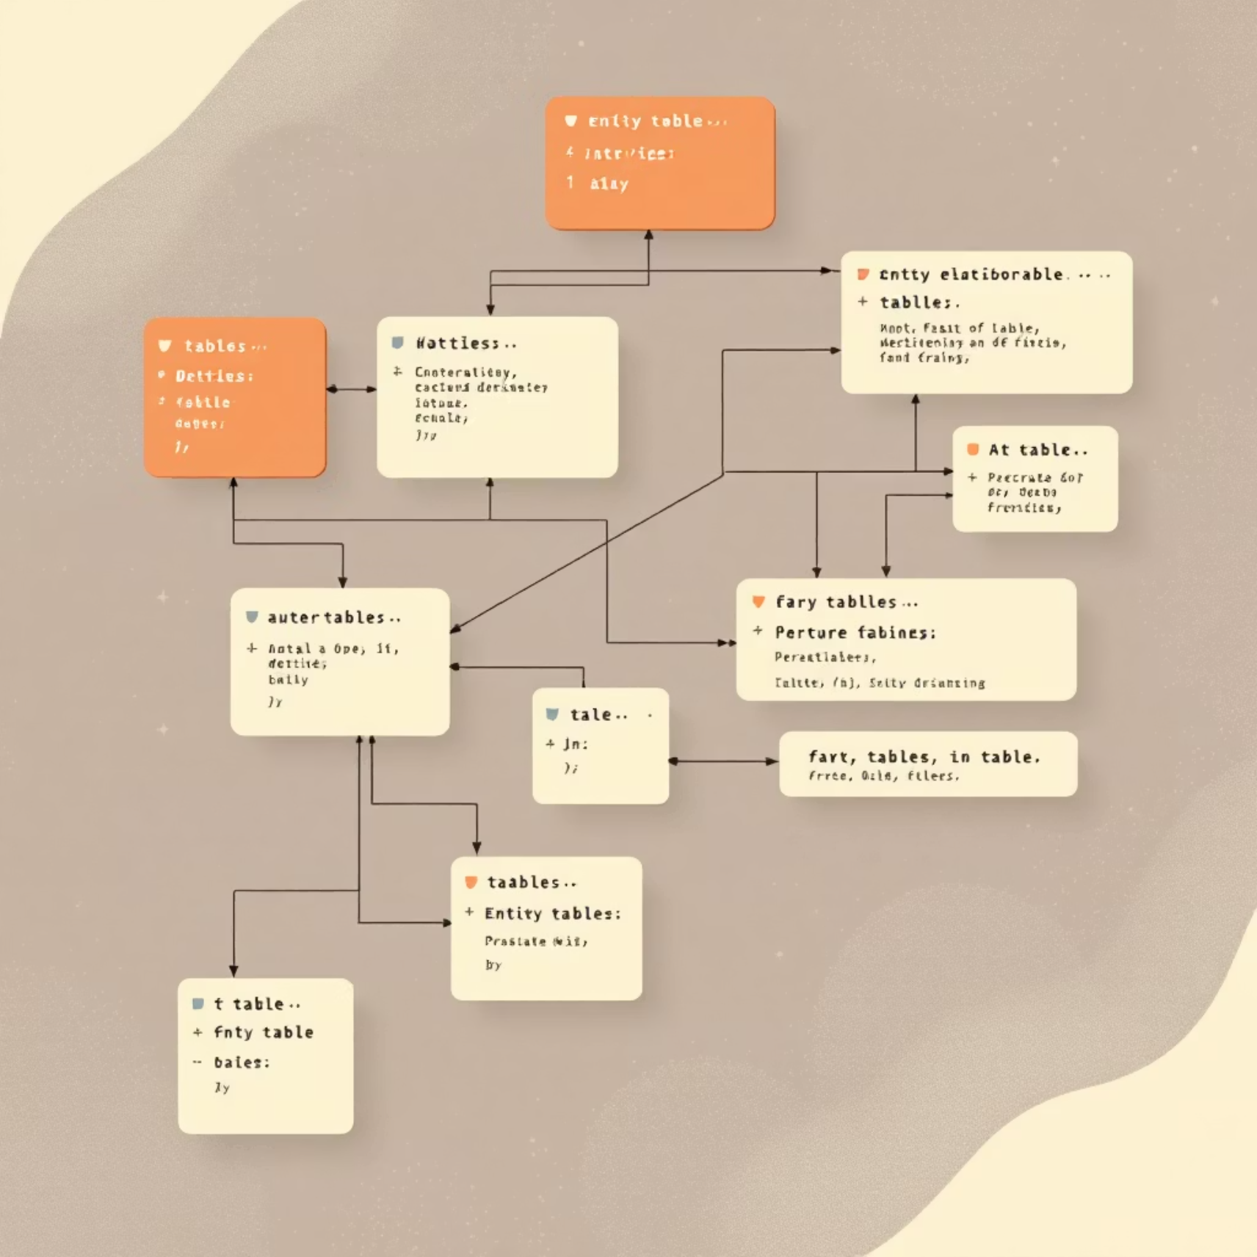
JOINS: CONNECTING RELATIONAL DATASETS
The ability to join data from multiple tables is fundamental in a relational database. This allows us to construct a complete view of business relationships, such as linking prescription data to patient demographics and dispensing pharmacists.
INNER JOIN: Returns only matching records.
LEFT JOIN: Returns all records from the left table, and the matched records from the right table.
RIGHT JOIN: Returns all records from the right table, and the matched records from the left table.
SELF JOIN: Joins a table to itself, useful for hierarchical data.
Example: Product and Manufacturer
SELECT p.product_name, m.manufacturer_name FROM Products p LEFT JOIN Manufacturers m ON p.manufacturer_id = m.manufacturer_id;

Slide 19





HIGHLIGHTS OF PHASE 2 COMPLETION
Extensive Application
SQL operations successfully applied to 25 pharmacy-related tables.
Full Command Spectrum
Mastery of the full command lifecycle: DDL, DML, and DQL, enhanced by advanced Joins and Clauses.
Real-Time Tracking
Demonstrated capabilities in constructing queries for real-time data monitoring (e.g., inventory levels, prescription status).
Analytics Foundation
Built a robust querying foundation necessary for integrating with high-level analytics and reporting tools.

Slide 20

Advanced SQL for Retail & Pharmacy Data
Phase 3: Mastering Relational Data Logic
This presentation outlines the objectives, core concepts, and outcomes of Phase 3, focusing on advanced SQL techniques necessary for robust data analysis and reporting across complex pharmacy and retail datasets.

Slide 21
PHASE 3 OVERVIEW
Scaling SQL Implementation
Advanced Implementation
Core Focus Areas
Applied sophisticated SQL logic across multiple critical pharmacy and retail database tables.
Mastery of Joins, Subqueries, Built-in Functions, and User-Defined Functions (UDFs).
Enhanced Automation
Practical Application
Dramatically improved data relationship handling and automated key analytical processes.
Developed practical SQL structures crucial for daily reporting, data validation, and business insights.

Slide 22




Key SQL Concepts in Phase 3
We utilized four foundational concepts to strengthen both data integrity and query performance in our environment.
Joins
Subqueries
Efficiently combine data across multiple relational tables.
Enable nested data extraction and conditional fetching for complex filtering.
Built-in Functions
User-Defined Functions (UDFs)
Leverage system functions for standard transformations and calculations (e.g., date formatting, aggregation).
Create custom, reusable SQL logic for business-specific calculations.

Slide 23

Foundation: Advanced Joins
Joins are essential for establishing links across interrelated tables like Products, Suppliers, Categories, and Sales, creating unified business insights.
Application
SQL Example: Product to Manufacturer
Cross-referencing product details with manufacturer data.
SELECT p.product_name, m.manufacturer_nameFROM Products pLEFT JOIN Manufacturers m ON p.manufacturer_id = m.manufacturer_id;
Linking sales transactions to customer records.
Ensuring all data points map back to a central key.
Using LEFT JOIN ensures that all products are listed, even if manufacturer data is currently missing.
This query merges product information with the corresponding manufacturer's name.

Slide 24

Conditional Logic: Subqueries
Subqueries allow for conditional or dependent data fetching, providing contextual and highly efficient filtering, particularly useful for identifying active or related records.
SQL Example: Identifying Active Suppliers
SELECT supplier_nameFROM SuppliersWHERE EXISTS ( SELECT 1 FROM Purchase_Orders po WHERE po.supplier_id = Suppliers.supplier_id);
This efficient use of EXISTS quickly identifies all suppliers who have at least one active purchase order in the system.
Key Uses
Filtering based on calculated values.
Validating relationships between tables.
Fetching data based on recent activity.

Slide 25




Streamlining Data: Built-in SQL Functions
Built-in functions apply system-defined calculations and conversions, simplifying the formatting and analysis of records directly within the query.
LENGTH()
DATE_FORMAT()
Used for data quality checks or text analytics.
Essential for standardized reporting and display purposes.
ROUND()
CASE Statements
Ensures precision for financial and inventory quantities.
Applies conditional logic for classification and categorization.
Example: Formatting Dates for Reporting
SELECT category_name, DATE_FORMAT(created_date, '%M %d, %Y') AS formatted_dateFROM Categories;

Slide 26
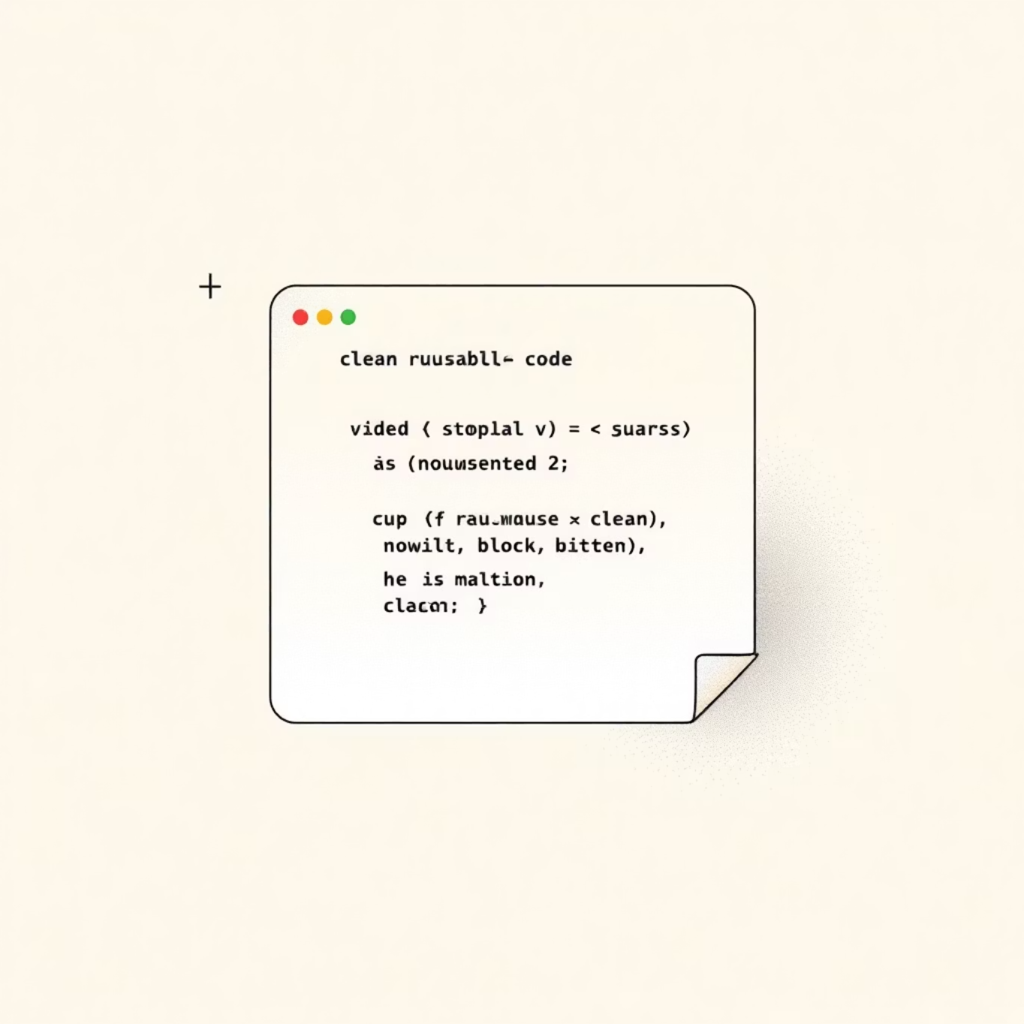
Extending Capability: User-Defined Functions (UDFs)
UDFs are custom SQL blocks that encapsulate business-specific logic, dramatically improving modularity, reusability, and maintainability across product and sales tables.
SQL Example: Calculating Discounted Price
CREATE FUNCTION GetDiscountedPrice(price DECIMAL(10,2), discount DECIMAL(5,2)) RETURNS DECIMAL(10,2) BEGIN RETURN price * (1 - discount / 100); END;
Once created, this function can be called in any query to consistently calculate pricing based on varying discounts.
Benefits
Centralized logic for complex formulas.
Reduced redundancy in large query sets.
Faster adaptation to changing business rules.

Slide 27



Generating Business Intelligence
Analytical and Reporting Queries
The combination of Joins, Aggregates, and UDFs enables the calculation of key metrics essential for performance tracking and trend evaluation.
Profit Margin Analysis
Total Orders Volume
Inventory Aging Reports
Calculate margins per product line using UDFs and aggregate costs.
Summarize transactional data to track daily, weekly, or monthly sales volume.
Evaluate how long stock has been held, highlighting potential write-offs or necessary clearance sales.
Simple Aggregation Example: SELECT SUM(total_amount) AS total_sales FROM Sales;

Slide 28
Ensuring Data Integrity
Data Validation via Subqueries
We use subqueries to perform critical dependency checks, ensuring data consistency and preventing orphan or invalid entries in our linked tables.
Example: Identifying Products Missing from Inventory
SELECT product_nameFROM ProductsWHERE NOT EXISTS ( SELECT 1 FROM Inventory i WHERE i.product_id = Products.product_id);
This technique is vital for maintaining a reliable database foundation, flagging records that violate assumed relationships.

Slide 29

Phase 3 Key Outcomes & Next Steps
Integrated Logic
Successfully integrated complex logic across Suppliers → Sales → Employees tables, demonstrating real-world relationships through multi-level joins.
20+ Advanced SQL constructs implemented.
Automated calculations and data classification.
Performance & Scalability
Ensured data accuracy, validation, and performance optimization, establishing a strong cross-table business intelligence foundation.
Strengthened BI foundation.
Enhanced scalability for future analytic layers.
Next Phase (Phase 4): Focus on developing advanced stored objects, including Views, Stored Procedures, and Triggers, to further optimize data access and manipulation.

Slide 30

Advanced SQL Mastery: Logic, Control, and Automation
Welcome to a deep dive into advanced SQL functionalities. This presentation focuses on the critical tools that transform simple database interaction into sophisticated data management, enhancing automation, security, and integrity for professional developers and data engineers.

Slide 31



Phase 4 Overview: Logic and Control Mechanisms
This phase concentrates on integrating sophisticated logic and control structures directly into the database engine. We move beyond simple queries to powerful, reusable components.
Data Abstraction
Programmatic Logic
Integrity and Security
Leverage Views and CTEs to simplify complex data access patterns.
Implement complex, reusable logic using Stored Procedures and Functions.
Manage permissions with DCL, transactions with TCL, and integrity with Triggers.
These components collectively build upon earlier database phases to ensure data is not only stored efficiently but is also analytically ready, secure, and consistently maintained.

Slide 32




Core Objectives for Advanced SQL Application
Our primary goals are to streamline operations, enhance system security, and ensure data reliability across all applications.
Automate Repetitive Tasks
Secure Data Access
Execute complex, repeatable sequences using parameterized Stored Procedures.
Manage user access and privileges precisely using DCL commands (GRANT/REVOKE).
Ensure Integrity
Simplify Reporting Logic
Maintain atomicity and consistency across multi-step changes with TCL operations.
Abstract and modularize intricate queries using Views and CTEs.

Slide 33

Views: Virtual Tables for Simplified Access
A View acts as a virtual table based on the result-set of an SQL query. They simplify data access for users and abstract complex underlying structures.
CREATE VIEW Active_Products AS SELECT product_id, product_name, unit_price FROM Products WHERE is_active = TRUE;
Views help encapsulate complex queries for specific business use cases, thereby improving database performance, enhancing security by limiting exposure to underlying tables, and increasing user accessibility to relevant data subsets.

Slide 34

Common Table Expressions (CTEs): Modular SQL Design
CTEs are temporary, named result sets defined within the scope of a single query. They are essential for breaking down complex, layered queries into readable, modular steps.
Example: Identifying high-value customers
Enhances Readability: Makes complex logic easy to follow.
WITH Total_Sales AS ( SELECT customer_id, SUM(total_amount) AS total FROM Sales GROUP BY customer_id )SELECT * FROM Total_Sales WHERE total > 5000;
Supports Recursion: Ideal for hierarchical data processing.
Temporary Scope: Does not clutter the database schema.

Slide 35
Stored Procedures: Encapsulating Business Logic
Stored Procedures are pre-compiled SQL code that can be stored and executed on the database server. They are fundamental for parameterized automation and enforcing business rules.
Reusability
Performance
Security
Call the procedure from any application without rewriting the SQL.
They are pre-compiled, leading to faster execution times.
Users can execute procedures without having direct permission on the underlying tables.
Example: Automating Inventory Updates
CREATE PROCEDURE UpdateStock(IN p_id INT, IN qty INT) BEGIN UPDATE Inventory SET quantity = quantity - qty WHERE product_id = p_id; END;

Slide 36

User-Defined Functions (UDFs): Consistent Computed Results
UDFs are routines that accept input parameters, perform calculations, and return a single value. They are crucial for maintaining modular design and ensuring consistent logic across queries and reports.
Example: Standardizing Tax Calculation
CREATE FUNCTION CalculateTax(amount DECIMAL(10,2)) RETURNS DECIMAL(10,2) RETURN amount * 0.18;
Support modular design and clean, readable queries.
Improve reporting accuracy by centralizing complex calculations.
Can be used directly within SELECT, WHERE, and HAVING clauses.

Slide 37



Data Control Language (DCL): Managing Security and Access
DCL is the part of SQL that deals with database access permissions and rights. It defines which users can perform which operations on the database objects.
GRANT
REVOKE
Used to give a user access privileges to a database object.
Used to take back permissions from a user.
Example: Securing Analyst Access
GRANT SELECT, INSERT ON PharmacyDB.* TO 'analyst'@'localhost';
This ensures the analyst can only read and add data, but not modify or delete critical information.

Slide 38



Transaction Control Language (TCL): Data Integrity
TCL commands are used to manage changes made by DML statements (INSERT, UPDATE, DELETE). They ensure data integrity by allowing developers to group multiple statements into an atomic transaction.
COMMIT
ROLLBACK
SAVEPOINT
Saves all changes made during the current transaction permanently.
Undoes all changes since the last COMMIT or START TRANSACTION.
Creates a point within a transaction to which you can later ROLLBACK.
Example: Ensuring an Update Completes Safely
START TRANSACTION; UPDATE Sales SET total_amount = total_amount + 100 WHERE sale_id = 1; COMMIT;
TCL guarantees the ACID properties (Atomicity, Consistency, Isolation, Durability), especially during potential failures.

Slide 39



Mastering Advanced SQL Components
Integrating these advanced components allows you to build more robust, secure, and efficient database applications.
Key Takeaways
Views & CTEs: Abstract complexity and enhance query readability.
Procedures & Functions: Centralize business logic for performance and reuse.
DCL & TCL: Enforce stringent security and transactional integrity.
Your next step is to practice integrating these controls into your daily development workflows.

Slide 40



Robust Error Handling in Stored Procedures
Stored procedures are critical for encapsulating complex business logic. Implementing robust error handling is essential for maintaining application stability, especially during transactional operations.
Safe Recovery via Handlers
Preventing Interruption
Stability and Audit Control
This mechanism prevents the entire transaction from being abruptly interrupted, allowing for graceful degradation or retry logic.
Procedures incorporate DECLARE HANDLER statements for safe recovery paths during runtime exceptions.
Strengthens overall system stability, enables detailed error logging, and facilitates comprehensive audit control.
DECLARE CONTINUE HANDLER FOR SQLEXCEPTION SET @error = 'Transaction failed';

Slide 41

Combining Views and User-Defined Functions (UDFs)
We leveraged the synergistic relationship between Views and UDFs to deliver instant, reusable analytical results directly from organized data structures.
Views serve to organize and simplify complex data joins and filtering logic (e.g., Customer_Sales_View).
Functions encapsulate complex calculations and metrics (e.g., CalculateTax).
The combination standardizes data access and ensures calculation consistency across all consuming applications.
Example Query:
SELECT customer_id, CalculateTax(total_amount) FROM Customer_Sales_View;

Slide 42



Integrated Use of TCL with Triggers
To balance automation with reliability, Transaction Control Language (TCL) commands are integrated into our Trigger logic, guaranteeing data consistency.
Automated Safety
Rollback Capability
Guaranteed Integrity
TCL commands (START TRANSACTION, COMMIT, ROLLBACK) ensure transaction safety within automated Trigger executions.
Enables instant rollback of all changes if any logic error or integrity constraint violation is detected within the trigger.
This process ensures that data modifications are atomic, consistent, isolated, and durable (ACID properties).
Implementation Logic:
START TRANSACTION; INSERT INTO Sales VALUES (...); IF error THEN ROLLBACK; ELSE COMMIT; END IF;

Slide 43




Phase 4 Highlights: Security, Consistency, and Automation
Phase 4 successfully integrated advanced programming and security features, laying the groundwork for full analytical deployment.
Advanced Security
SQL Reusability
Automation Foundation
Implemented Data Control Language (DCL) and robust access controls, ensuring data is protected and consistent.
Reduced manual maintenance and risk of errors through procedures, functions, and views that centralize core logic.
Triggers and transactional controls provide automated workflow processing and rigorous data integrity enforcement.

Slide 44



PHASE 5: COMPREHENSIVE QUERY MASTERY
The final phase confirms the functional completeness and performance readiness of the entire database solution, surpassing initial targets.
100%
13
120+
Implementation Success
Categories Mastered
Total Queries
All query categories were fully implemented and tested with complex, real-world business scenarios.
Comprehensive coverage from foundational DDL/DML to advanced techniques like window functions and triggers.
Total queries developed and documented, exceeding the target requirement and ensuring robust system testing.
Technical Milestones Achieved: Comprehensive error handling, full performance optimization, and the implementation of a scalable database architecture are complete.

Slide 45
Database Management System Mastery: The 5-Phase Journey
We completed a full-cycle database development, transforming conceptual ideas into a robust, deployment-ready system.
01: Database Design & Modeling
1
ER diagrams, relationship mapping, and normalization to 3NF standards with comprehensive schema design.
2
02: Implementation & Structure
Built 25 optimized tables with advanced constraints, indexing, and data integrity enforcement.
03: Advanced Querying
3
Complex business logic implementation using multi-table operations and performance optimization strategies.
4
04: Programming & Security
Stored procedures, functions, transaction management (TCL/DCL), and automated triggers.
05: Comprehensive Query Mastery
5
Validated 120+ queries across all categories, ensuring full system integration and readiness.

Slide 46

System Achievements & Future Vision
Technical Excellence Delivered
Complete Solution
Advanced Features
End-to-end consulting firm management system with scalable multi-user architecture and robust security protocols.
Includes performance optimization, comprehensive error handling, and automated workflow processing via Triggers/Procedures.
Business Value
Enables efficient resource management and real-time analytical capability for data-driven decisions.

Slide 47




Future Enhancement Roadmap
The current architecture provides a stable foundation for future strategic expansions and technological upgrades.
Cloud Database Migration
Transitioning to a robust cloud platform for enhanced scalability, availability, and reduced operational costs.
AI-Powered Analytics Integration
Integrating machine learning models for predictive analysis, trend forecasting, and enhanced business intelligence.
Mobile Application Development
Creating native mobile access for key stakeholders to view and manage resources on-the-go.
Real-time Dashboard Implementation
Developing dynamic reporting dashboards for instant visualization of critical business metrics.

Slide 48

THANK YOU
Project Completed — Ready for Deployment 🚀
120+ SQL Queries Implemented: Comprehensive coverage across 13 major categories.
5 Phases of Database Mastery Completed: From design modeling to full system integration.
Optimized and Scalable: Built for real-world scenarios with optimized performance and high data integrity.
Presented by: Vivek ChincholkarDatabase Development & SQL Project Lead

